Slide 1

ALTA Wireless G-Force Snapshot Sensor

Slide 2
Introduction
The ALTA Wireless Accelerometer - G-Force Snapshot Sensor is a digital, low-power, low-profile, capacitive sensor that is able to measure acceleration on three axes to determine inclination.
Takes 3-axis g-force measurements.
4096 count/g sensitivity.
The ALTA Wireless G-Force Snapshot Sensor Accelerometer activates at a set time interval (defined by user) and measures g-force along X, Y and Z axes. Primary use is as an inclinometer or tilt sensor.
There are three operating modes, ±2 G, ±4 G, or ±8G. The data is displayed as g-force on each axis

Slide 3
Features
Wireless range of 1,200+ feet through 12+ walls.
Frequency-Hopping Spread Spectrum (FHSS).
Improved interference immunity.
Improved power management for longer battery life ** (12+ years on AA batteries).
Encrypt-RF® Security (Diffie-Hellman Key Exchange + AES-128 CBC for sensor data messages).
All ALTA sensors now have up to 3200 readings: - 10-minute heartbeats = 22 days - 2-hour heartbeats = 266 days.
Over-the-air updates (future proof).
Free iMonnit basic online wireless sensor monitoring and notification system to configure sensors, view data and set alerts via SMS text and email.

Slide 4
Example Applications
Inclination & vibration testing
Orientation sensing
Impact Load Sensing
Assembly Line Monitoring

Slide 5
Setup and Installation
Register gateway on iMonnit. Your gateway must be registered first to verify communication between the device and iMonnit. Any sensors or meters you wish to add onto your network must come after the gateway.
Register G-Force Snapshot Sensor on iMonnit.
After you’ve registered your gateway, it’s time to add your G-Force Snapshot Sensor to the iMonnit account.
Mount sensor. Place your sensor in the desired spot using screws or double-sided tape. Make sure you have the correct antenna orientation to receive a strong signal.
This type of sensor is powered by using a coin cell battery.

Slide 6
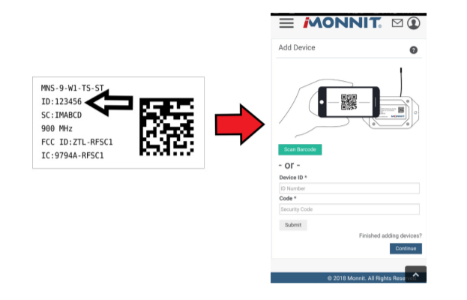
Registering Sensor
Log into iMonnit.
Enter the Device ID and the Security Code from the G-Force Snapshot Sensor in the corresponding text boxes.
Use the camera on your smartphone to scan the QR code on your sensor and gateway. If you do not have a camera on your phone, or the system is not accepting the QR code, you may enter the Device ID and Security Code manually.
The Device ID is a unique number located on each device label
When completed, select the “Submit” button.

Slide 7
Setting up Sensor
When finished adding the sensor to your account, the next step is to insert the battery.
The type of battery you use will depend on the category of your sensor. ALTA Wireless G-Force Snapshot Sensors will either be powered by commercial coin cell, AA, or an industrial battery.

Slide 8
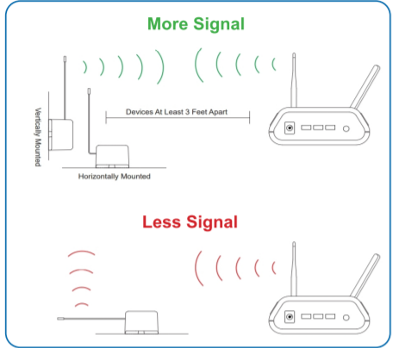
Antenna Orientation
In order to get the best performance out of your ALTA Wireless Sensors, it is important to note proper antenna orientation and sensor positioning.
Antennas should all be oriented in the same direction, pointing vertically from the sensor.
If the sensor is mounted flat on its back on a horizontal surface, you should bend the antenna as close to the sensor housing as possible giving you the most amount of antenna pointing vertical.
You should make the antenna wire as straight as possible, avoiding any kinks and curving of the wire.
Sensors must be at least 3 ft. away from other sensors and the wireless gateway to function.

Slide 9
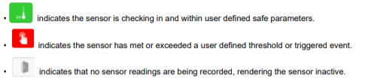
Sensor Overview In iMONNIT
Select Sensors from the main navigation menu on iMonnit to access the sensor overview page and begin making adjustments to your G-Force Snapshot Sensors.
Details - Displays a graph of recent sensor data.
History - List of all past heartbeats and readings.
Events - List of all events attached to this sensor.
Settings - Editable levels for your sensor. Directly under the tab bar is an overview of your sensor. This allows you to see the signal strength and the battery level of the selected sensor.
Calibrate - Reset readings for your sensor.
Directly under the tab bar is an overview of your sensor. This allows you to see the signal strength and the battery level of the selected sensor

